Slide 1
SuperPoints
REESE WILLIAMS
JOHN HOANG | OLIVER JANG | HENRY JIANG | HARMAN MINHAS

Slide 2
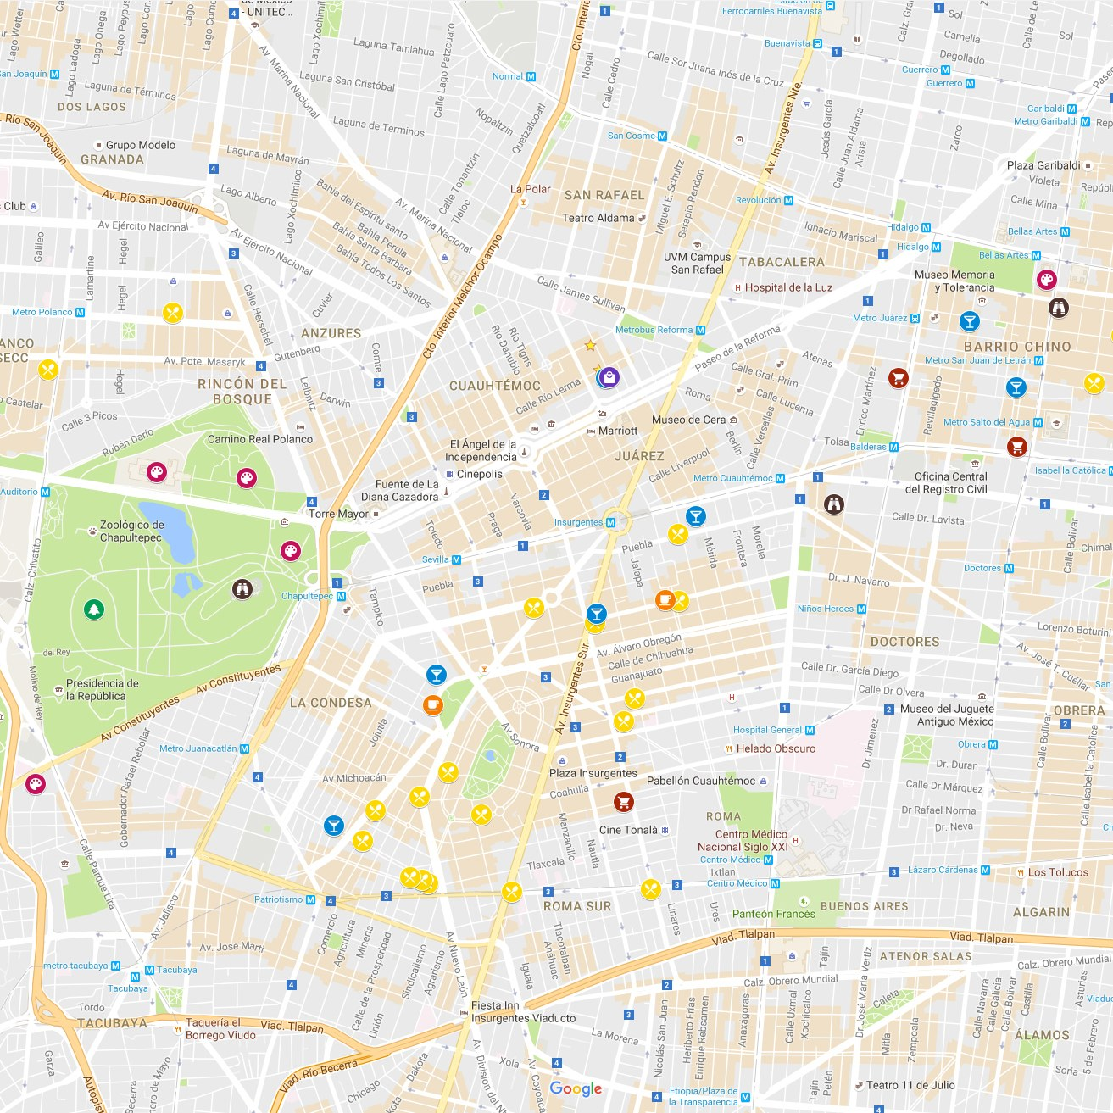


The Idea

